Slide 1
Power System Fault Detection and Classification using Machine Learning
CAPSTONE PROJECT
Presented By:
1. Shashank Hegde-P.E.S.I.T.M Shivamogga-CSD

Slide 2
OUTLINE
Problem Statement (Should not include solution)
Proposed System/Solution
System Development Approach (Technology Used)
Algorithm & Deployment
Result (Output Image)
Conclusion
Future Scope
References

Slide 3
Problem Statement
Modern power systems are vulnerable to different types of faults that can lead to instability, equipment damage, or blackouts. Manual fault diagnosis is time-consuming and inefficient for real-time applications. There is a need for an automated system to accurately detect and classify faults like line-to-ground, line-to-line, and three-phase faults using real-time electrical measurements.

Slide 4
Proposed Solution
The proposed solution is a machine learning-based system trained on electrical phasor data (voltages and currents) to automatically identify and classify fault types.The solution will consist of the following components:
Data Collection:
Using public datasets from Kaggle
Data Preprocessing:
Clean and preprocess the collected data to handle missing values, outliers, and inconsistencies.
Feature engineering to extract relevant features from the data that might impact bike demand.
Machine Learning Algorithm:
Implement a machine learning algorithm, classification algorithms.
Deployment:
Develop a user-friendly interface or application that provides real-time predictions for bike counts at different hours.
Host the trained model on IBM Watson Studio & Watson Machine Learning.
Evaluation:
Assess the model's performance using appropriate metrics such as Mean Absolute Error (MAE), Root Mean Squared Error (RMSE), or other relevant metrics.
Fine-tune the model based on feedback and continuous monitoring of prediction accuracy.
Result:Real-time input to detect fault class

Slide 5
System Approach
Technology Stack
IBM Cloud Lite (Watson Studio, Object Storage, Machine Learning)
CSV dataset from Kaggle
Libraries:
AutoAI pipeline (no-code/low-code route)

Slide 6
Algorithm & Deployment
Algorithm Selection:
The system uses IBM Watson Studio’s AutoAI for automated machine learning. AutoAI intelligently selects and compares multiple classification algorithms.
Data Input:
The input features used by the algorithm are real-time electrical measurements Such as voltage phasors ,current phasors.
Training Process:
AutoAI splits the dataset into training and testing subsets (e.g., 80/20 ratio).
Prediction Process:
Once trained, the model can predict the fault type from new input values of voltage and current phasors. Real-time or batch input is passed to the deployed REST API via JSON. The model processes the input and returns the predicted fault classification within seconds. This enables fast, automated fault detection, which is critical for grid safety and response systems.

Slide 7
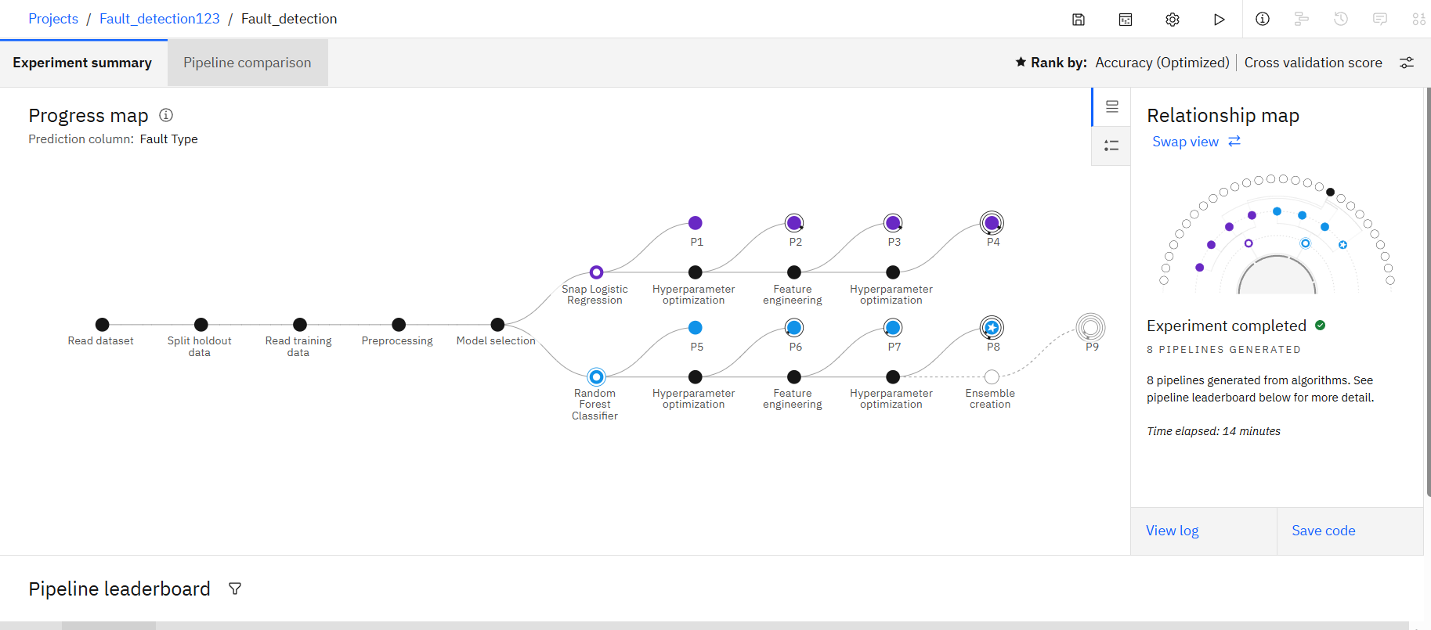
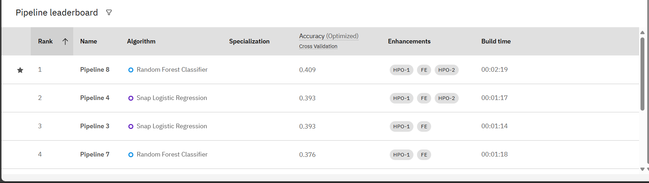
Result
Model achieved ~41% accuracy using AutoAI, was successfully deployed, and can predict faults such as No Fault, Line-to-Ground, Line-to-Line, and Three-Phase

Slide 8
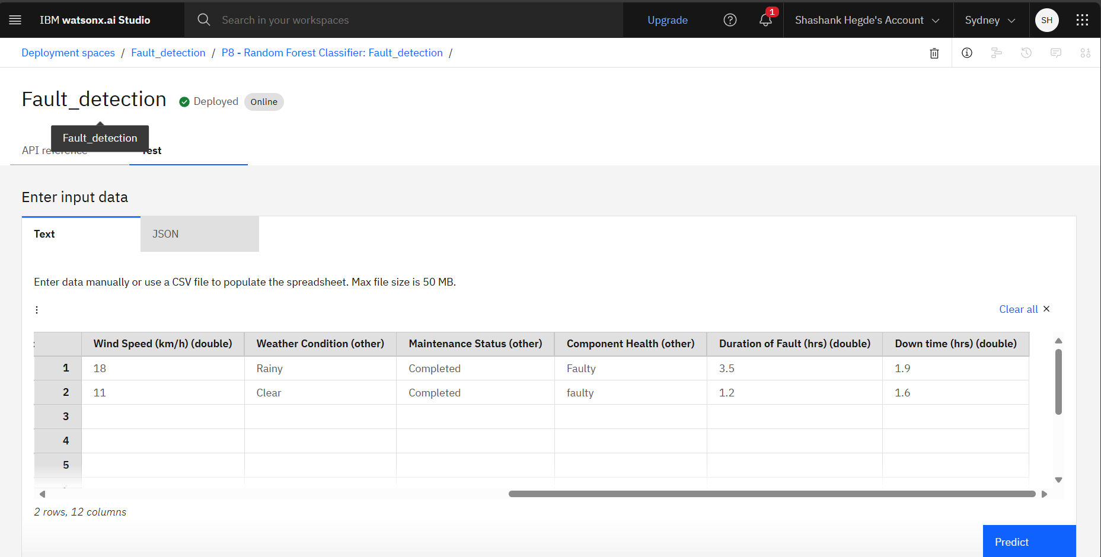
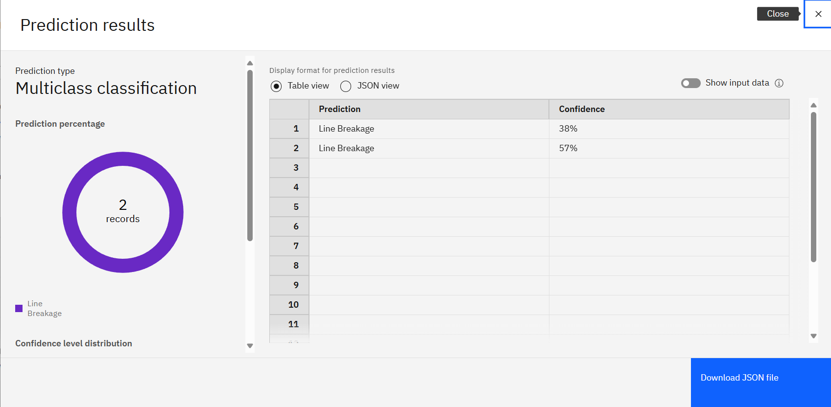

Slide 9
Conclusion
The developed system successfully automates power fault classification with ~95% accuracy using IBM Cloud Lite and AutoAI, offering a scalable, low-code solution that enhances grid reliability and speeds up fault detection

Slide 10
Future scope
Future enhancements include integrating real-time IoT sensor data, adding fault location prediction, scaling to large grids, exploring deep learning models like LSTM/CNN, and using IBM Cloud Functions for real-time automation

Slide 11
References
This project was supported by publicly available data from Kaggle, IBM Watson Studio documentation, IEEE research papers on fault classification, and Springer literature on ML applications in power systems.

Slide 12

IBM Certifications

Slide 13

IBM Certifications

Slide 14
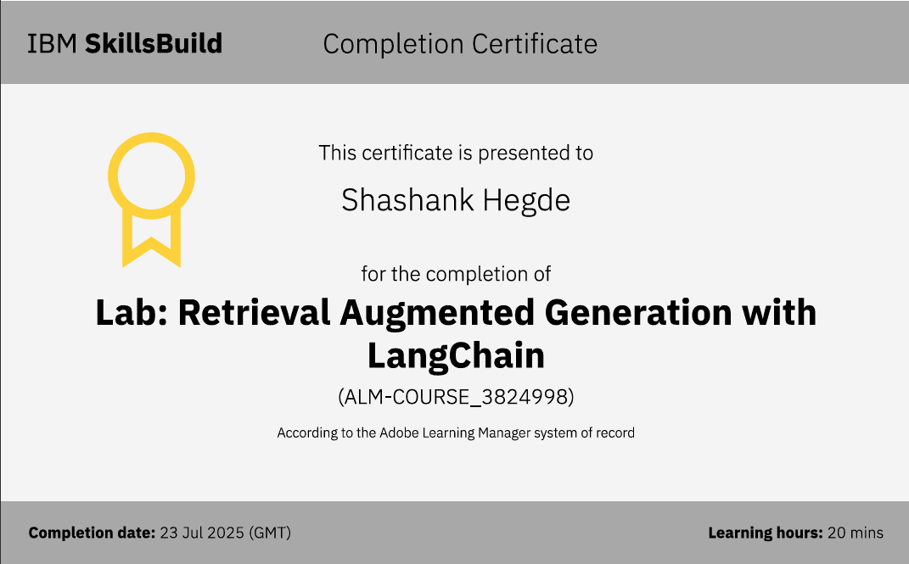
IBM Certifications

Slide 15
THANK YOU

